Slide 1
Knight Sweeper 4200
Group 9
Phong Le (EE)
Josh Haley (CPE)
Brandon Reeves (EE)
Jerard Jose (EE)

Slide 2

Overview
Autonomous Robot
Start to end autonomous route
Detection of Improvised Explosive Devices
GPS Enabled
Obstacle Avoidance

Slide 3
Motivation
Use of IED has increased since the Vietnam War
Technology improves but yet death by IED increases
Low Budget spending on platforms used for detecting IED’s

Slide 4
Goals
Scan terrain based on start to end autonomous route
Detection of IED
Notify and pinpoint location of detection
Avoid any obstacles encountered on route
Navigate on desert like terrain

Slide 5
Specifications
Hardware:
  - Aluminum chassis
  - Four wheels, 2 inch diameter
  - Four DC geared brushless motors
  - Digital video camera with resolution not yet determined based on bandwidth availability
  - Infrared sensors for obstacle detection and navigation
  - Zigbee USB 802.15.4 wireless module (Range 100m indoors and 1000m line-of-sight)
  - 14.8V Li-Polymer battery pack, provide up to two hours of operation
  - Host PC runs on Windows
Software:
  - Design Embedded Program in C\C++
  - Embedded Program must run in a small memory space and fit in onboard flash.
  - Must be robust to possible errors.
  - Must successfully navigate the robot toward its goals.
  - Reliable communication with PC software.

Slide 6
Requirements
Knightsweeper shall be able to autonomously through a terrain
Knightsweeper will operate on battery power
Knightsweeper shall be able to detect IED’s with in a range of ()
Knightsweeper shall avoid collisions with obstacles
Knightsweeper shall be able to map its path and navigate to a destination via GPS and A* algorithm.
Knightsweeper shall be able to communicate and send data to the user via telemetry

Slide 7
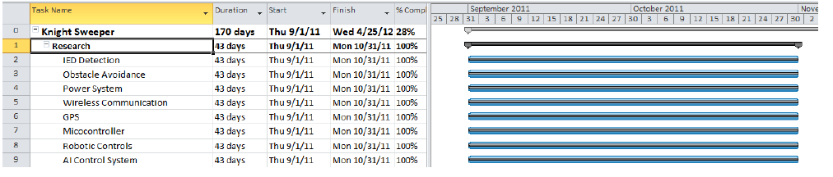
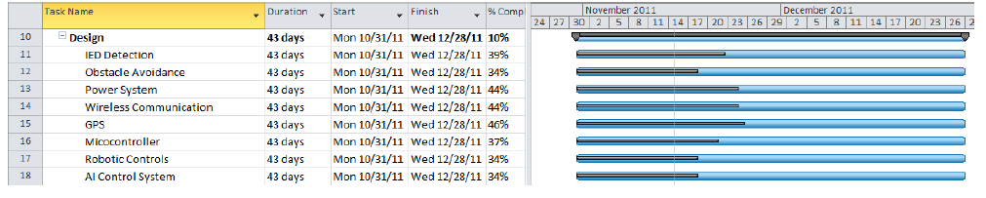
Project Schedule & Milestones
RESEARCH
DESIGN

Slide 8
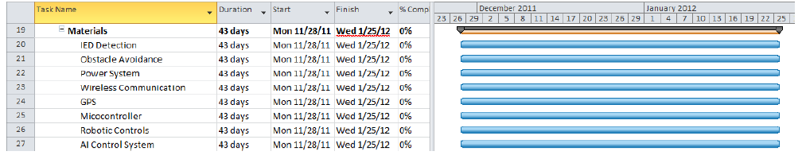
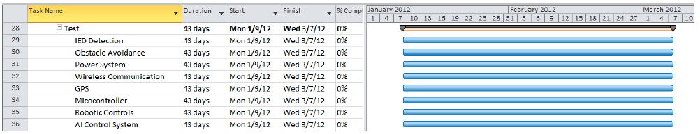
Project Schedule & Milestones
MATERIALS
TEST

Slide 9
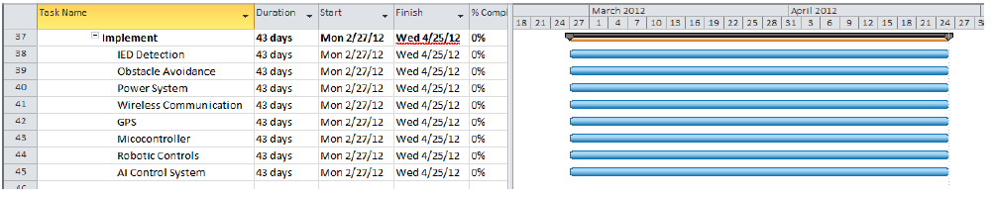
Project Schedule & Milestones
IMPLEMENTATION

Slide 10
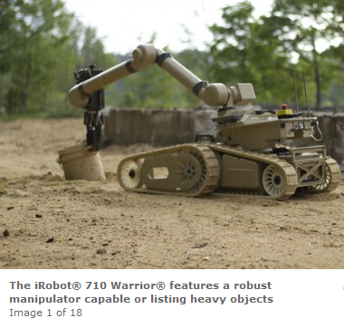
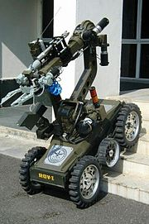
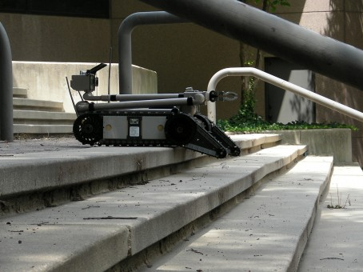
Existing Solutions
DRDO Daksha

Slide 11
IED Detection
Pulse Induction
  One coil sending pulses of current
  Detection through opposite magnetic field from metal object
  Pulse then collapses causing reflected pulse to last longer (echo)
Very Low Frequency
  Two coils, one transmitter the second receiver
  Transmitting coil emits alternating current to create a magnetic field
  Pulses back and forth and reacts once conductive object is detected
  Receiver coil reads secondary magnetic field caused by conductive object
Beat Frequency Oscillation
  Two separate coils oscillator and a search coil
  Oscillator creates a constant signal at a set frequency
  Detection of metal by search coil creates a magnetic field
  Magnetic field interferes with radio frequency, offset in frequency then creates an audible beat

Slide 12
Obstacle Avoidance
Use of Ultrasonic and Infrared Sensors.
  TwoMaxbotix LV-MaxSonar-EZ0 High Performance Module mounted on front
    Detection Range 6”-245” w/ 45 degree beam width
  Two Sharp GP2D12 IR Sensors mounted on sides
    Detection Range 3cm to 30cm

Slide 13
Power System
Integrated Power Supply
  12 VDC
    Server motors
  9 VDC
    IED Detection
  5 VDC
    GPS Navigation
    StellarisMicrocontroller
    GPS Navigation
    Stellaris Microcontroller

Slide 14
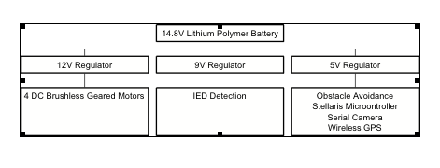
Power System Block Diagram

Slide 15
Rover Platform
Identify type, size, wheels and motors.
A New Design
Use an existing design

Slide 16
Motor Control
Identify how the vehicle will move.
Determine algorithm for obstacles.
Determine algorithm for detected IED.
Verify motor controller functionality.

Slide 17
AI Navigation
Problem: Quickest Way from A to B avoiding all known obstacles and suspected IEDs
Use the A* algorithm to find the shortest path
Upon IED/Obstacle detection, remove location from the search path and run A* again!

Slide 18
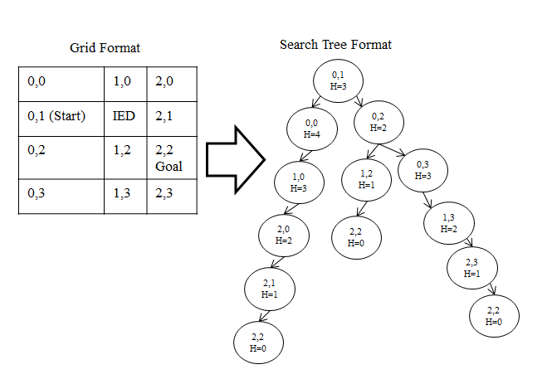
AI Navigation

Slide 19
Embedded Software
Needs to accept messages from a PC controller.
  Command robot to autonomous, and allow for manual control of systems.
Needs to implement the described AI algorithm
Must initialize and access all of the various
  interfaces of the robot.

Slide 20
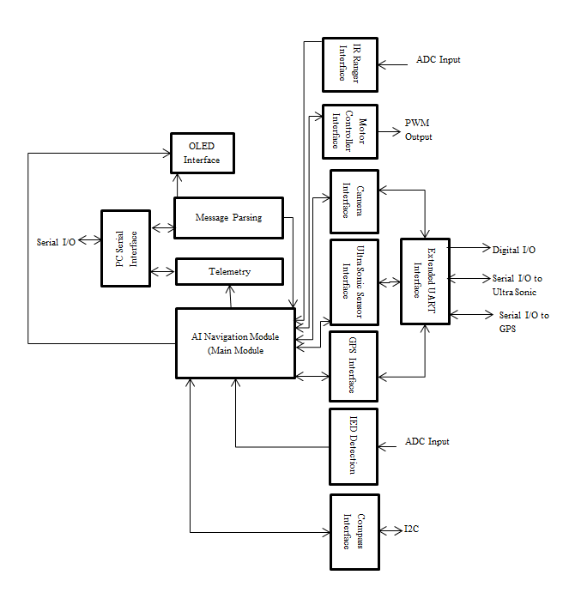
Embedded Software

Slide 21
PC Software
PC Software will allow for operator use and will facilitate debugging.
Manually command robot, get sensor data.
Receive constant telemetry from the robot indicating state and location.
Display the robot’s progress on a map display
Display images of suspected IED’s

Slide 22
Microcontroller
Stellaris M3 8962 Dev board.
Stellaris offers high computational power at 62.5 MIPS.
Offers 64K of RAM
  Important for the A* algorithm
Interrupt Driven
Abundance of code examples and libraries

Slide 23
Project Challenges/Risk Assessment
GPS lack of accuracy
EMF Interference
Power consumption
Wireless Communication Interference
Communication Errors between Sensors, motors, GPS, microcontroller

Slide 24
Distribution of Responsibilities
Phong Le
  IED Detection
  Project Management
Josh Haley
  GPS
  Serial Camera
  Main Board
  Lead Software Engineer
Brandon Reeves
  Obstacle Avoidance
  Power Systems Lead
Jerard Jose
  Motor control lead
  Platform Selection

Slide 25
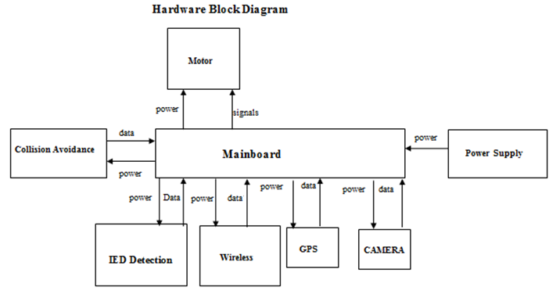
Platform Overview

